Slide 1
Breast Cancer Survival Project – Python

Slide 2
Brief about Breast Cancer
Problem Statement
Importing Packages
Loading Dataset
Pandas Profiling
EDA
Conclusion

Slide 3
Problem Statement
2. Problem Statement
1. What is the age of the patient getting infected?
2. Relationship of variable(Age, Nodes and Years of Operation) with rest to Survival?
3. In Which years most successful operations were conducted?
4. Which factors contributes most to the survival?

Slide 4
Importing the Packages
import numpy as np
import pandas as pd
import pandas_profiling
import matplotlib.pyplot as plt
import seaborn as sns
%matplotlib inline
sns.set()
!pip install plotly --upgrade
!pip install chart-studio

Slide 5
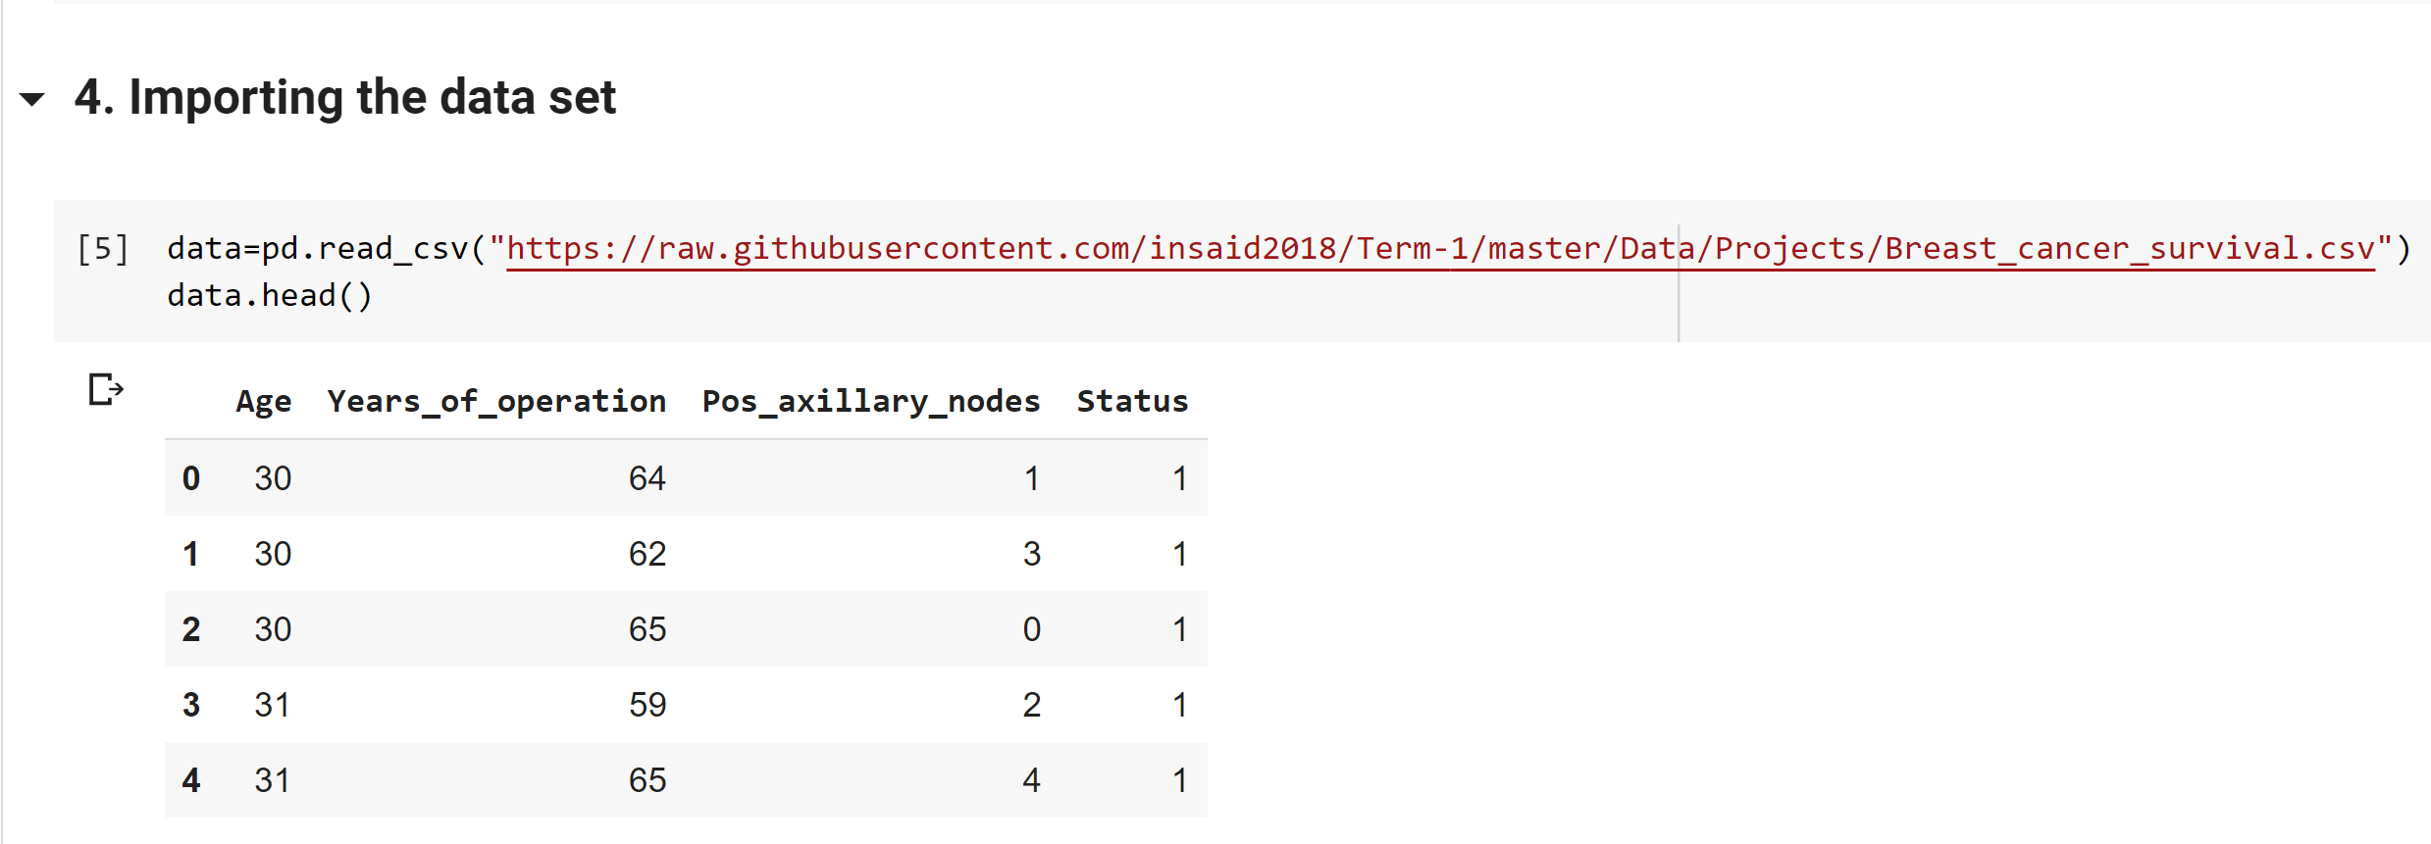
Importing the data set

Slide 6
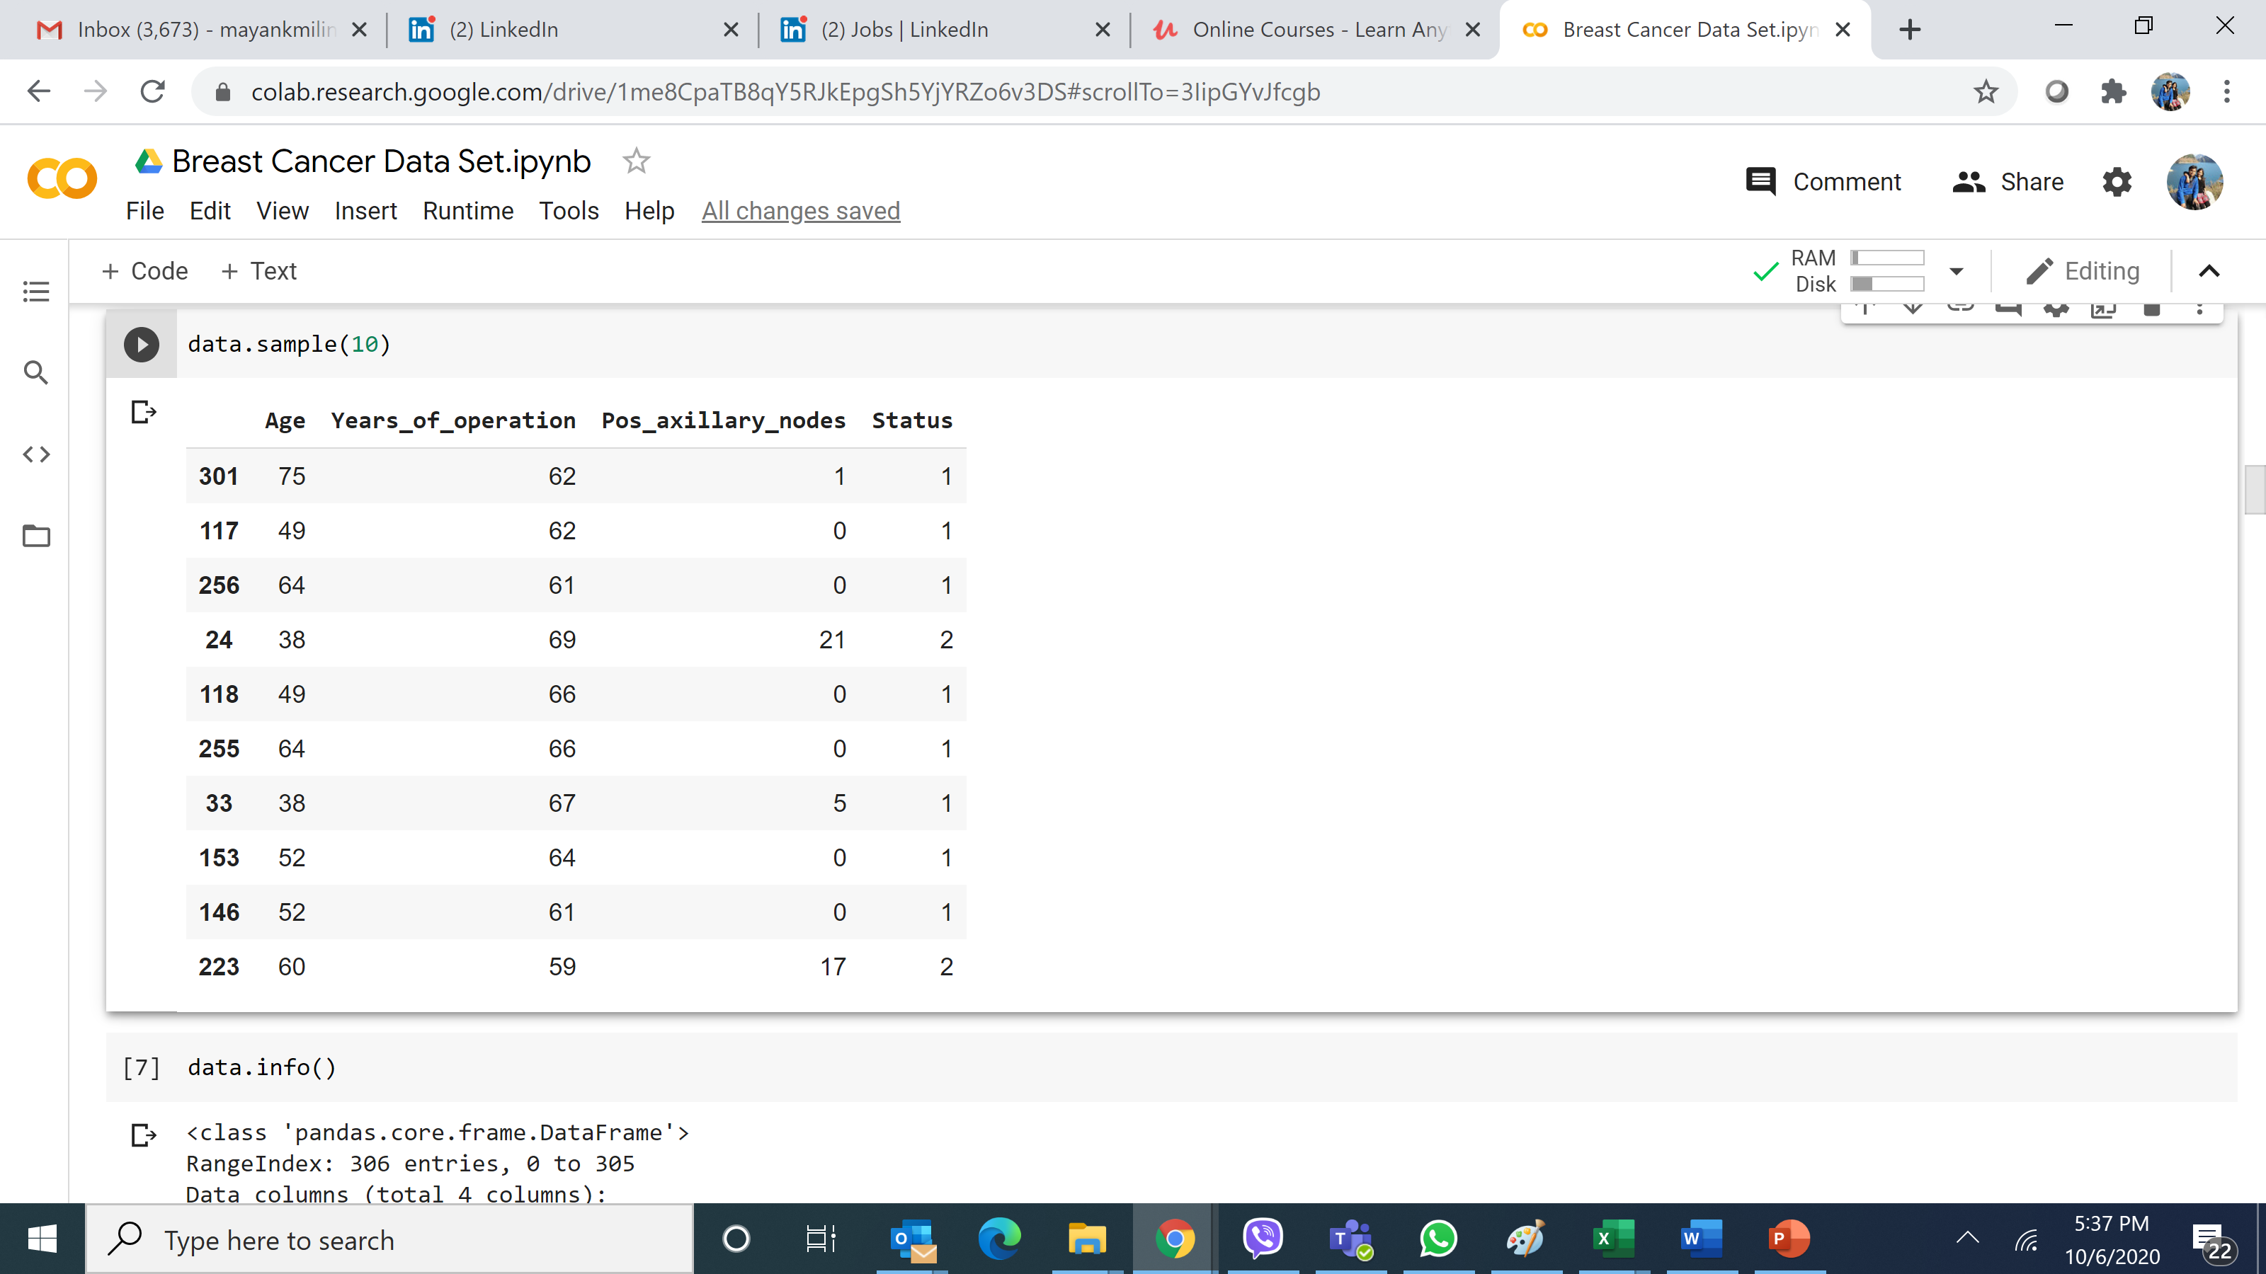
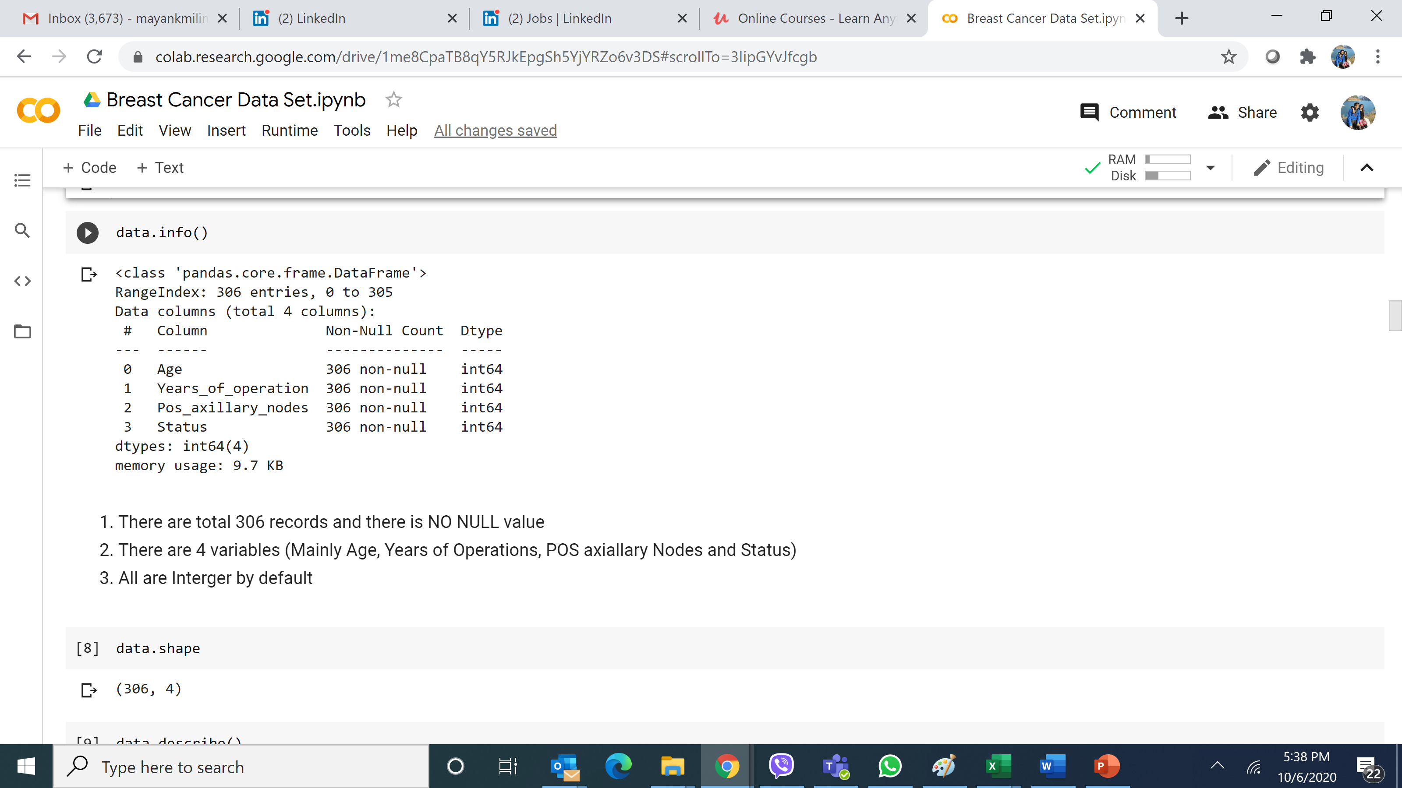
Performing Basic EDA

Slide 7
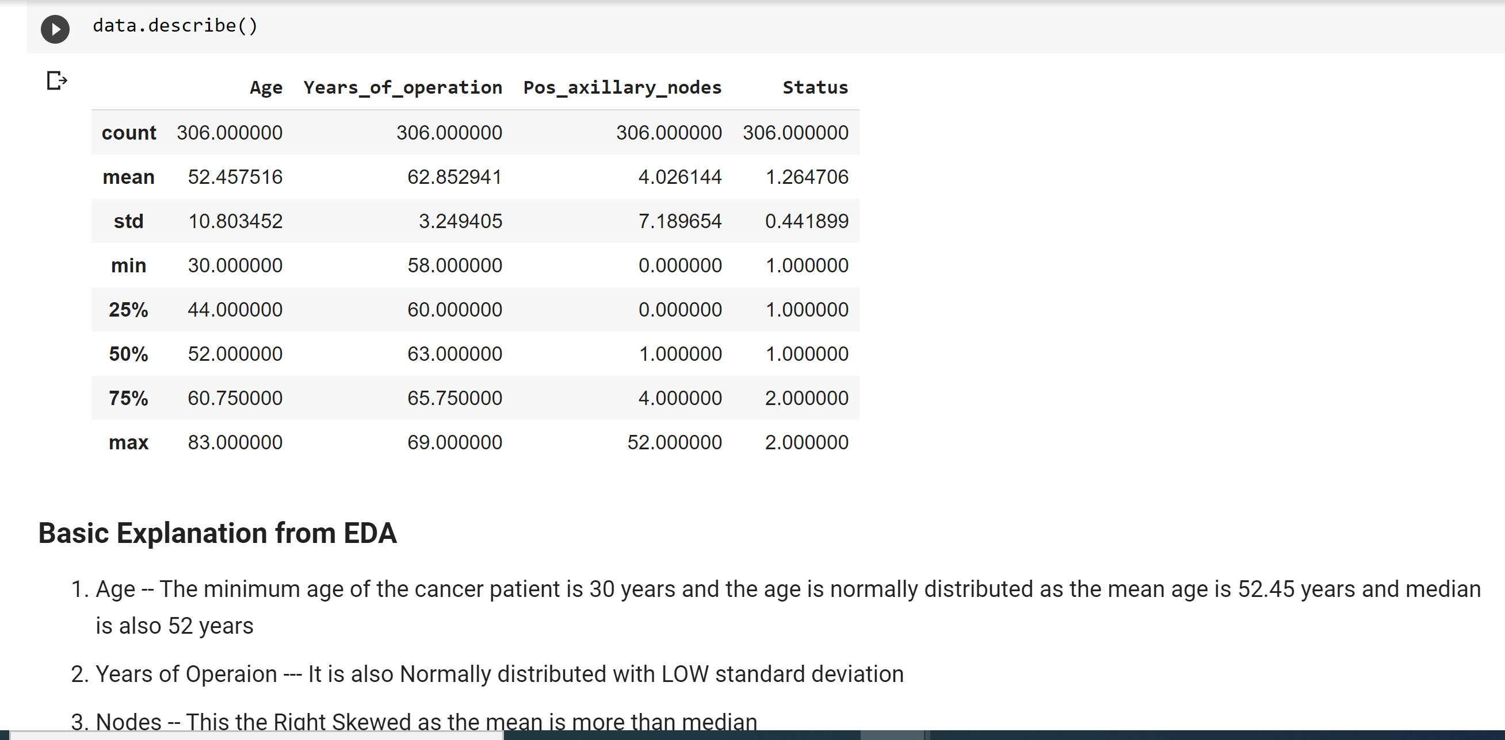
Performing Basic EDA

Slide 8
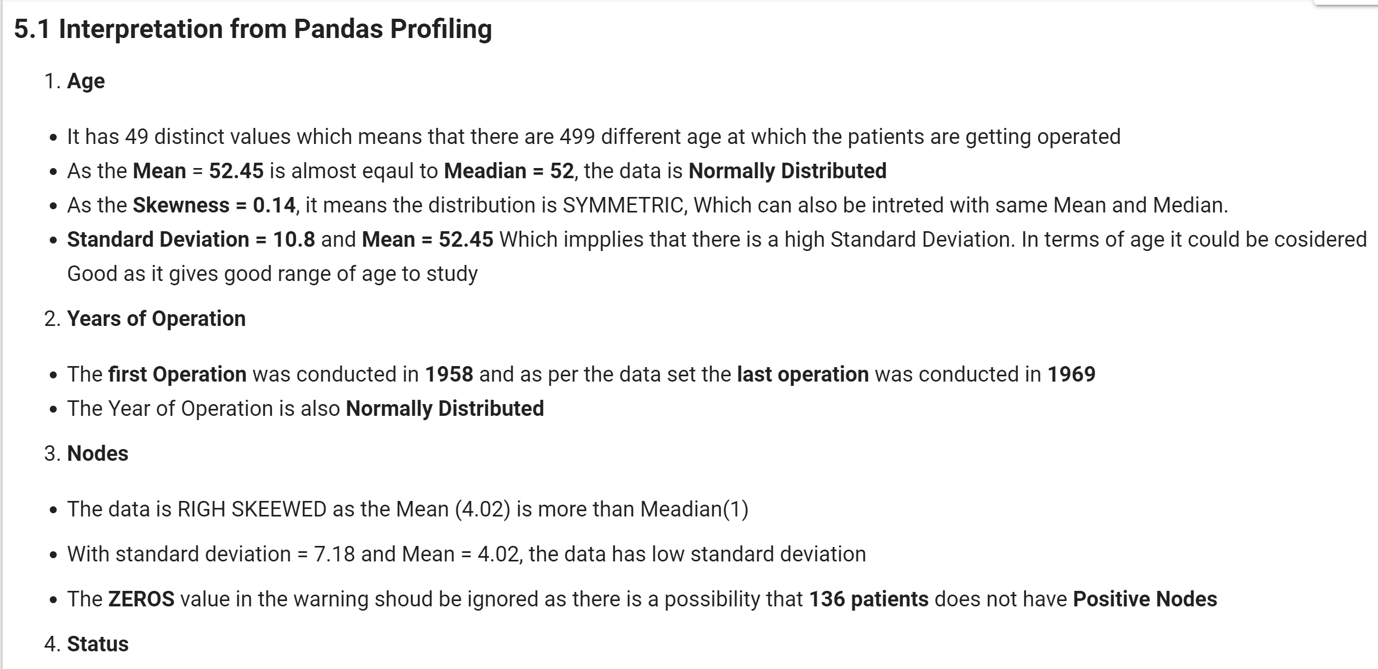
Interpretation from Pandas Profiling

Slide 9
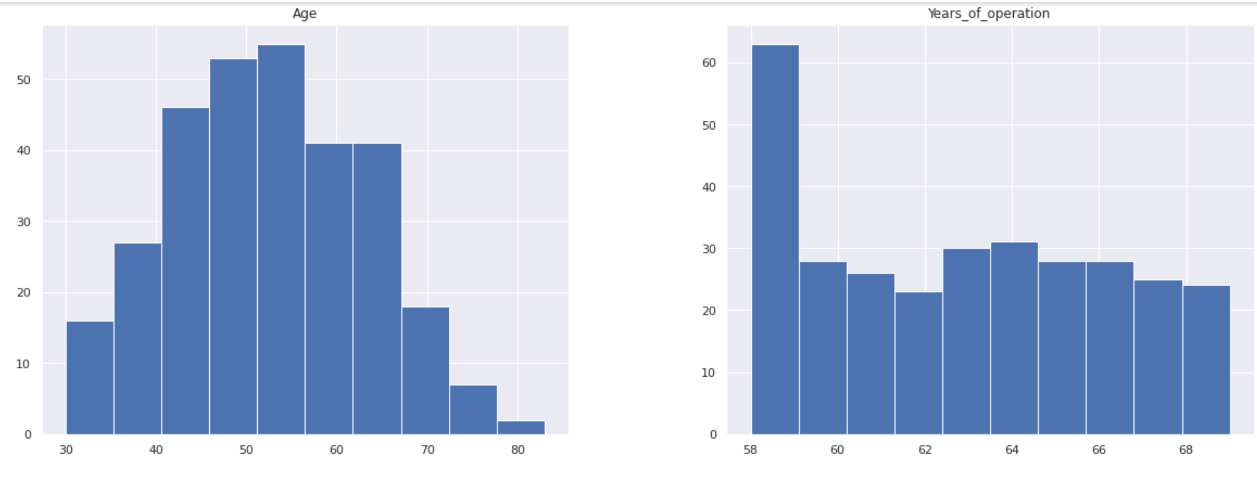
Overall distribution of Data for all Parameters

Slide 10
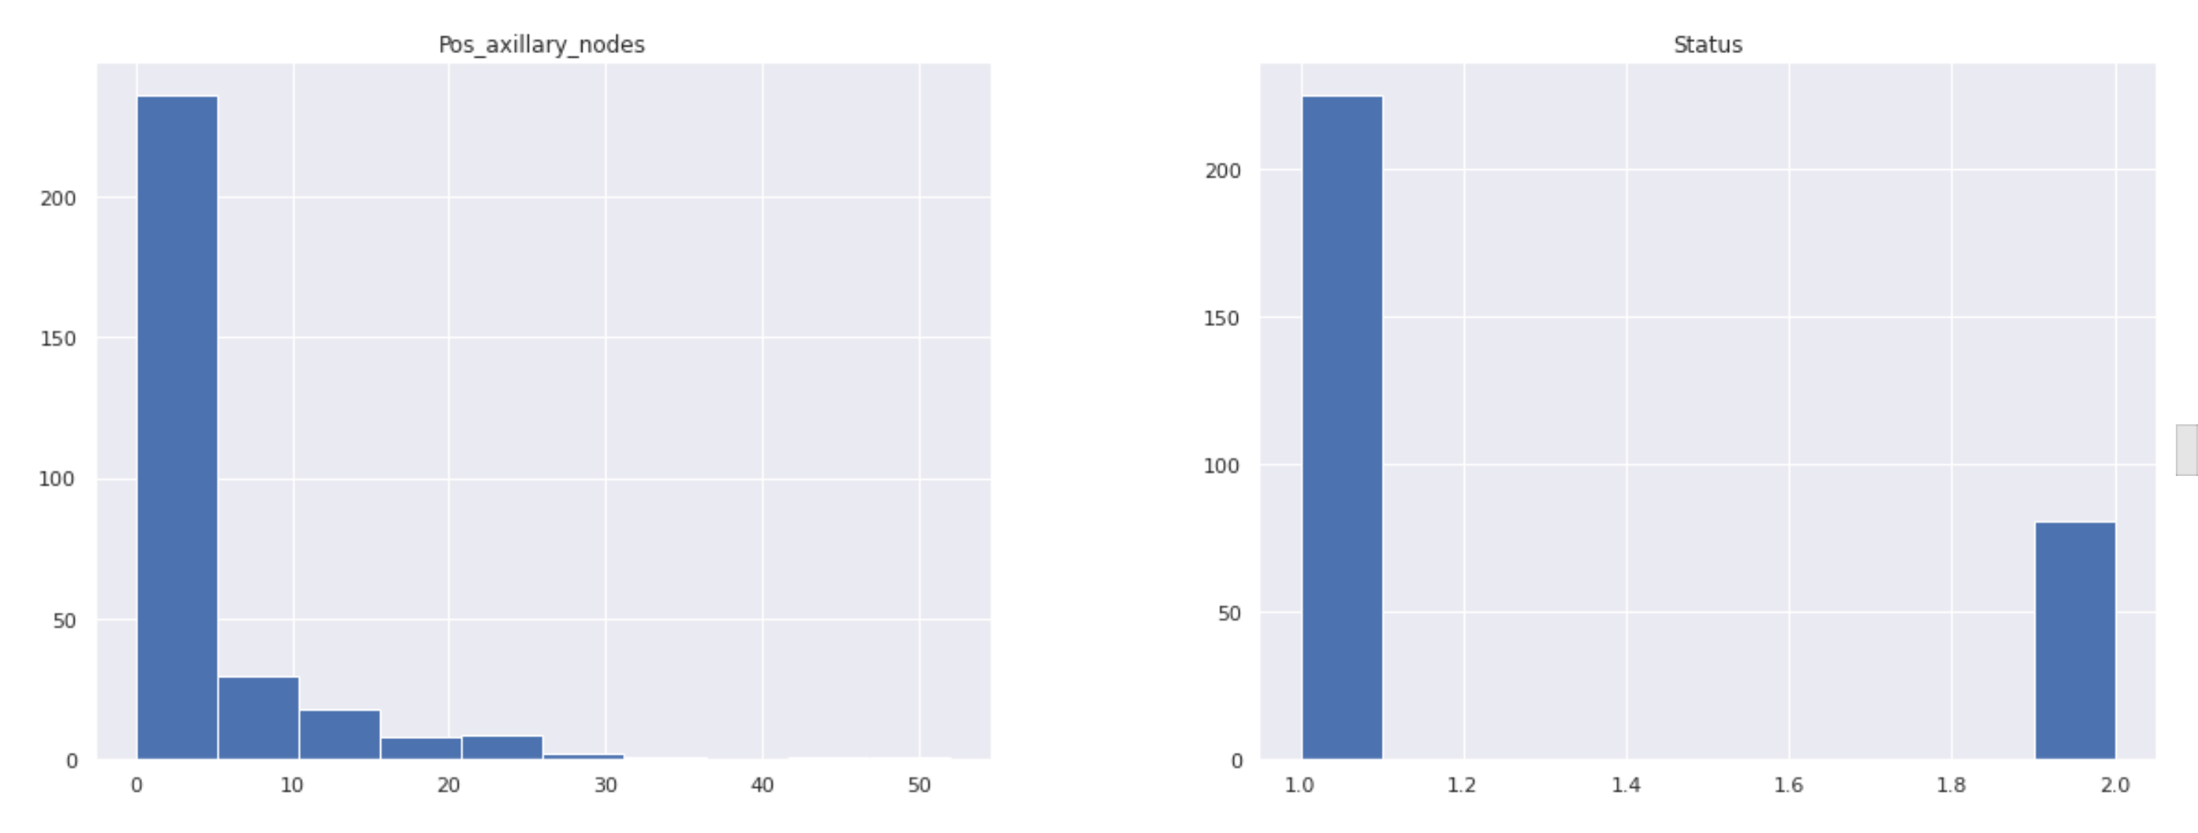
Overall distribution of Data for all Parameters

Slide 11
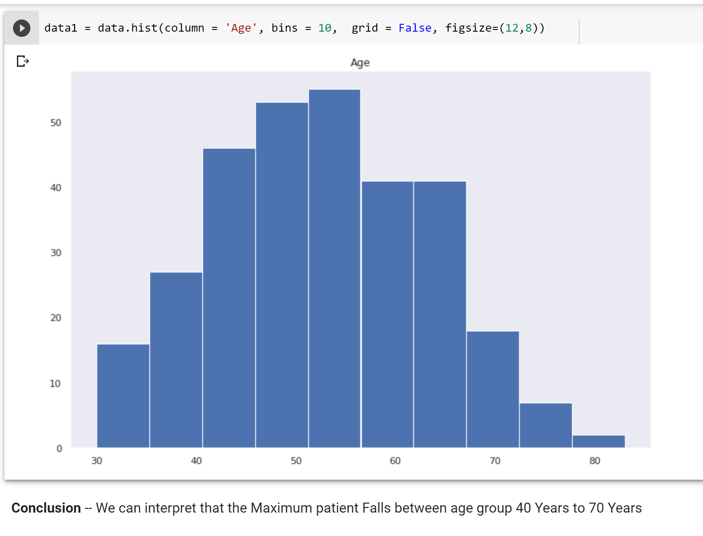
EDA
What is the age group of the patient getting infected?

Slide 12
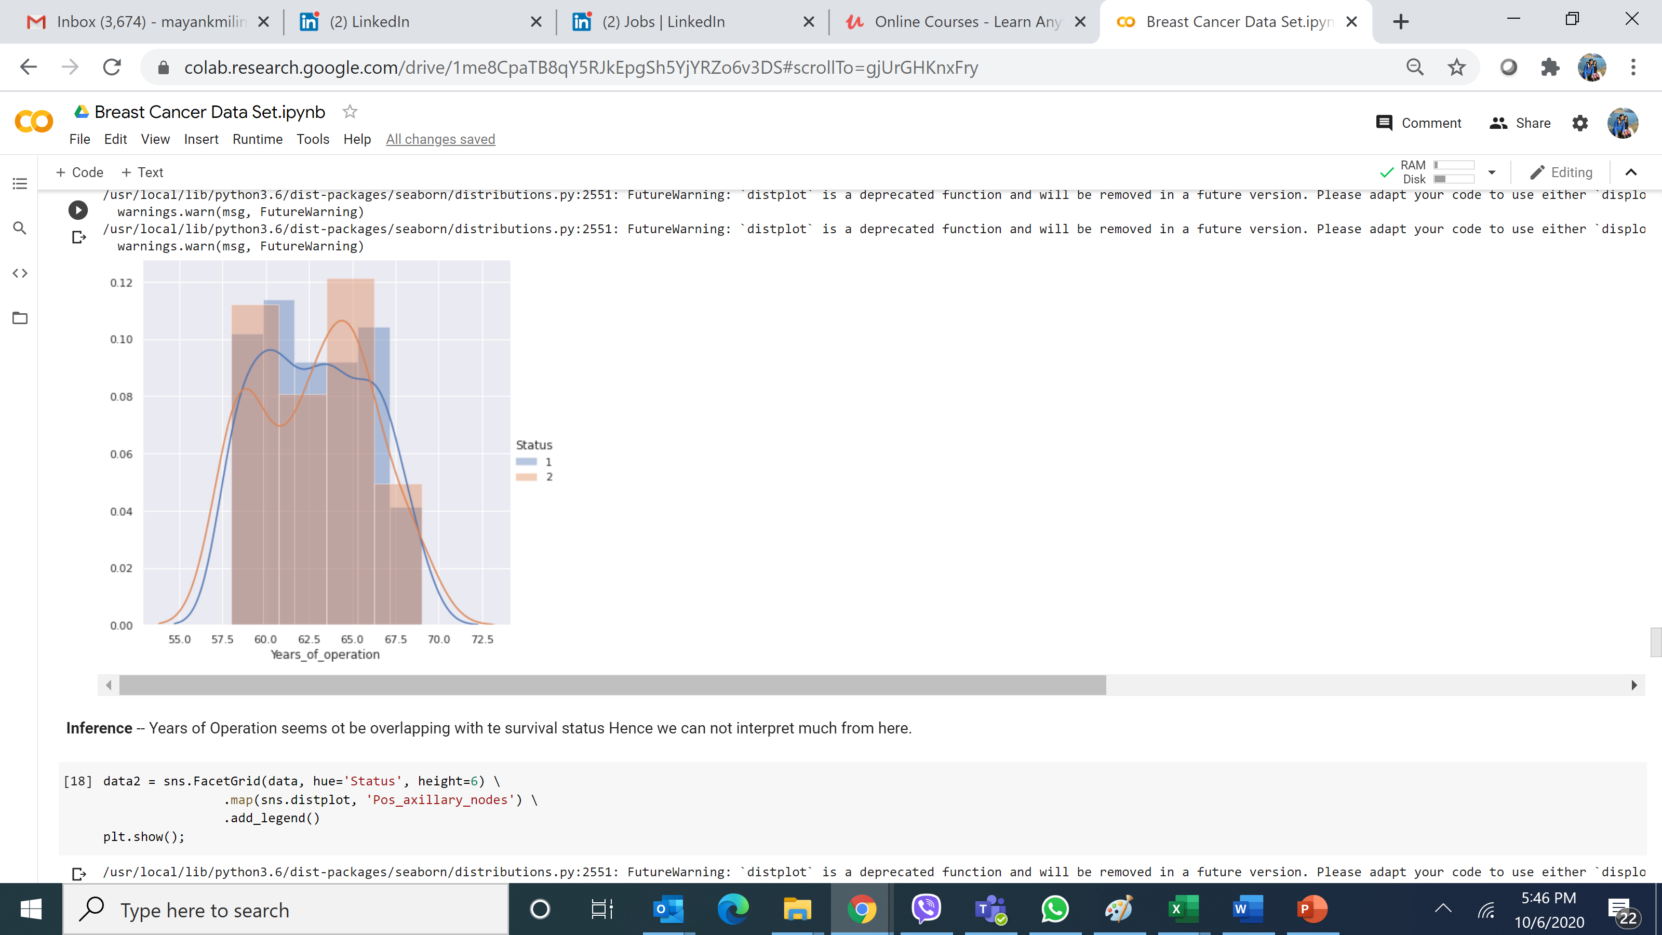
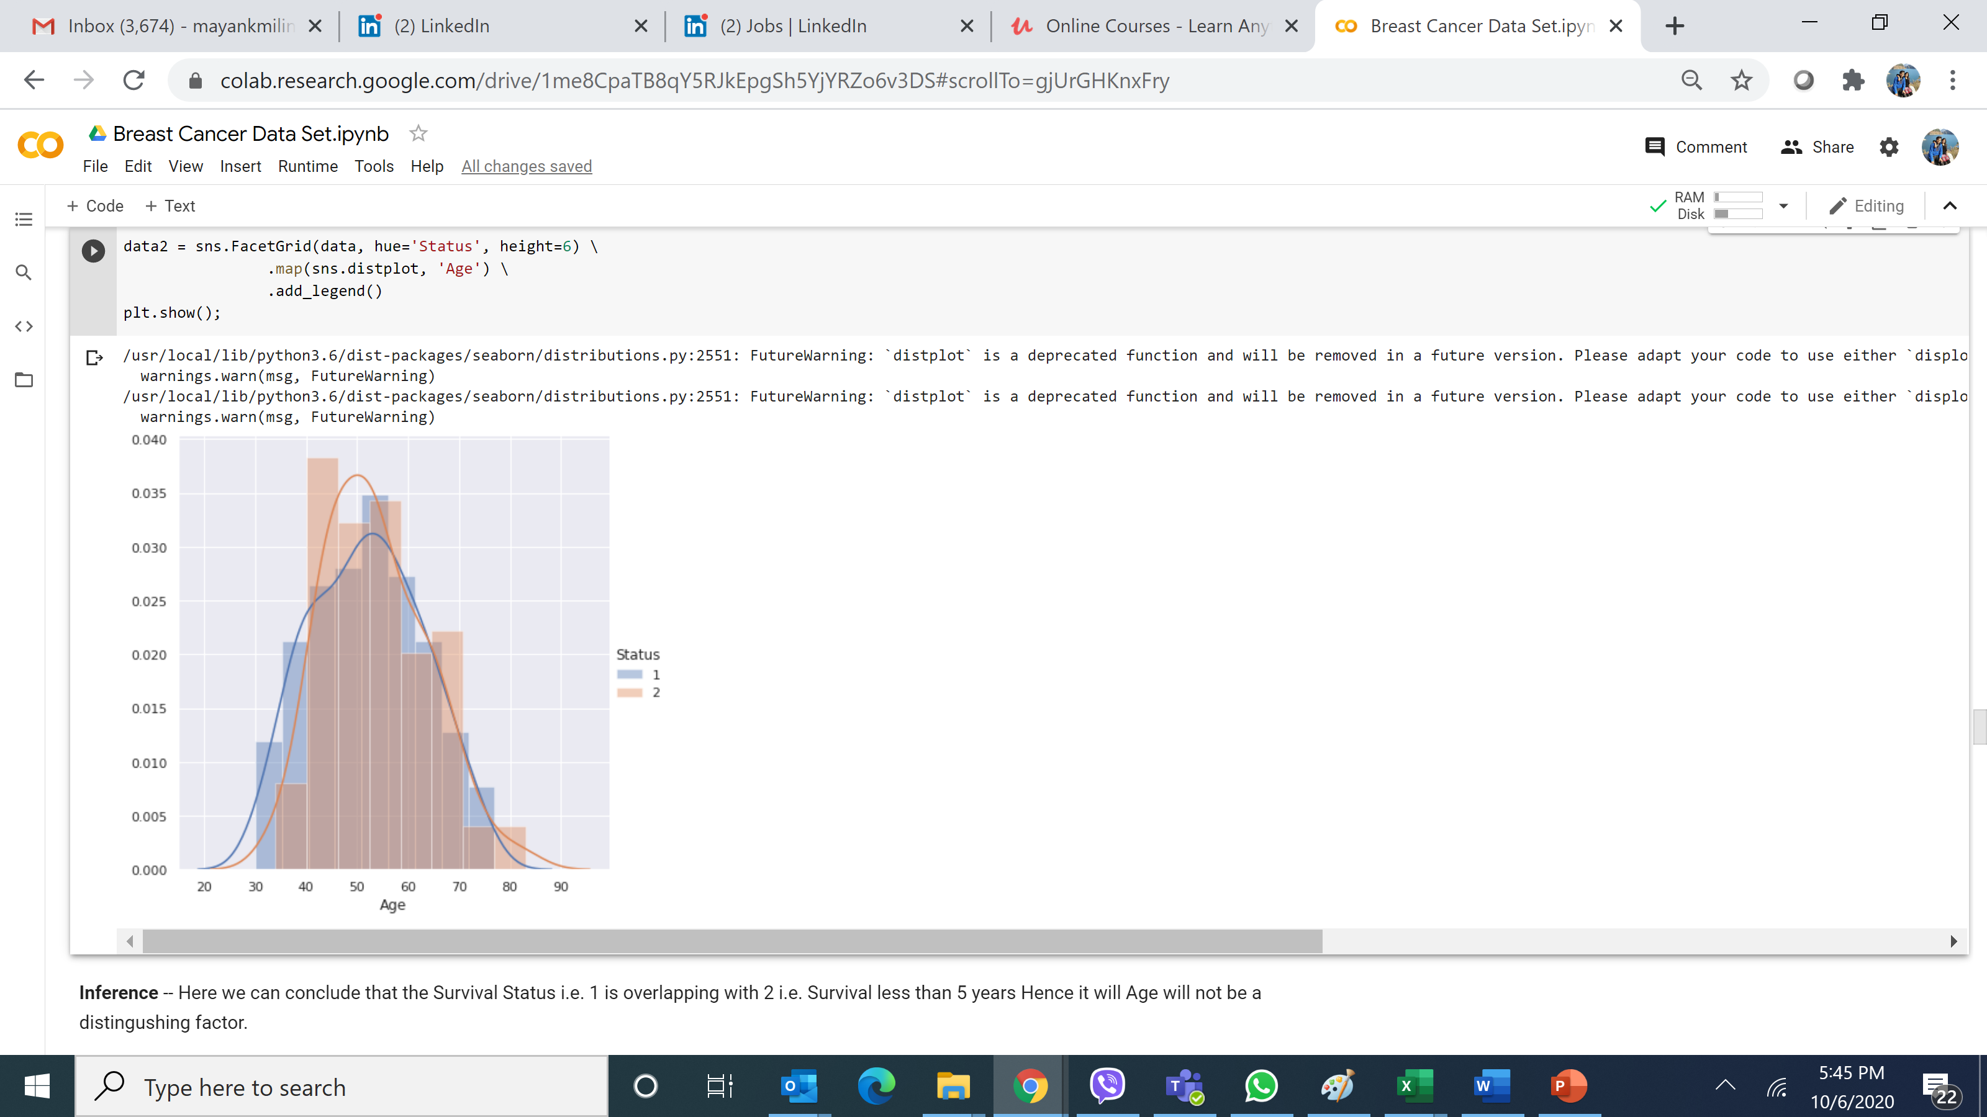
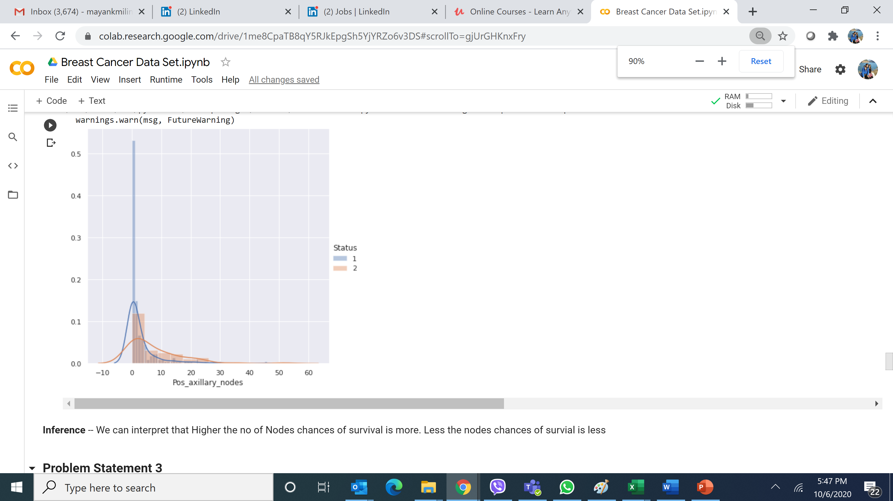
Relationship of variable(Age, Nodes and Years of Operation) with rest to Survival?

Slide 13
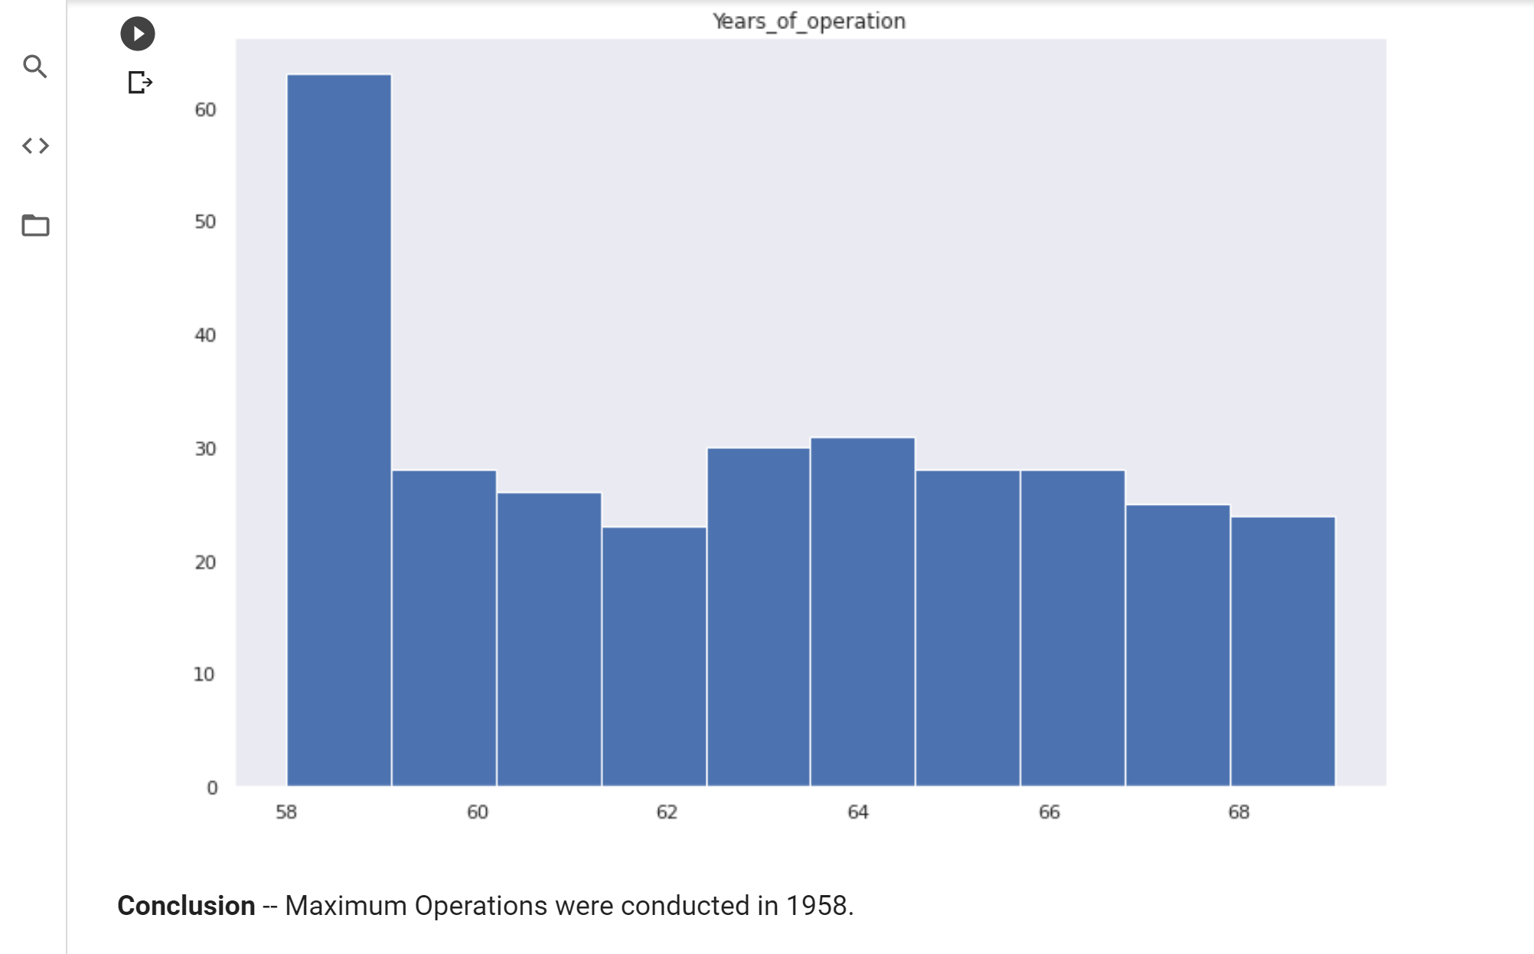
In Which years most successful operations were conducted?

Slide 14
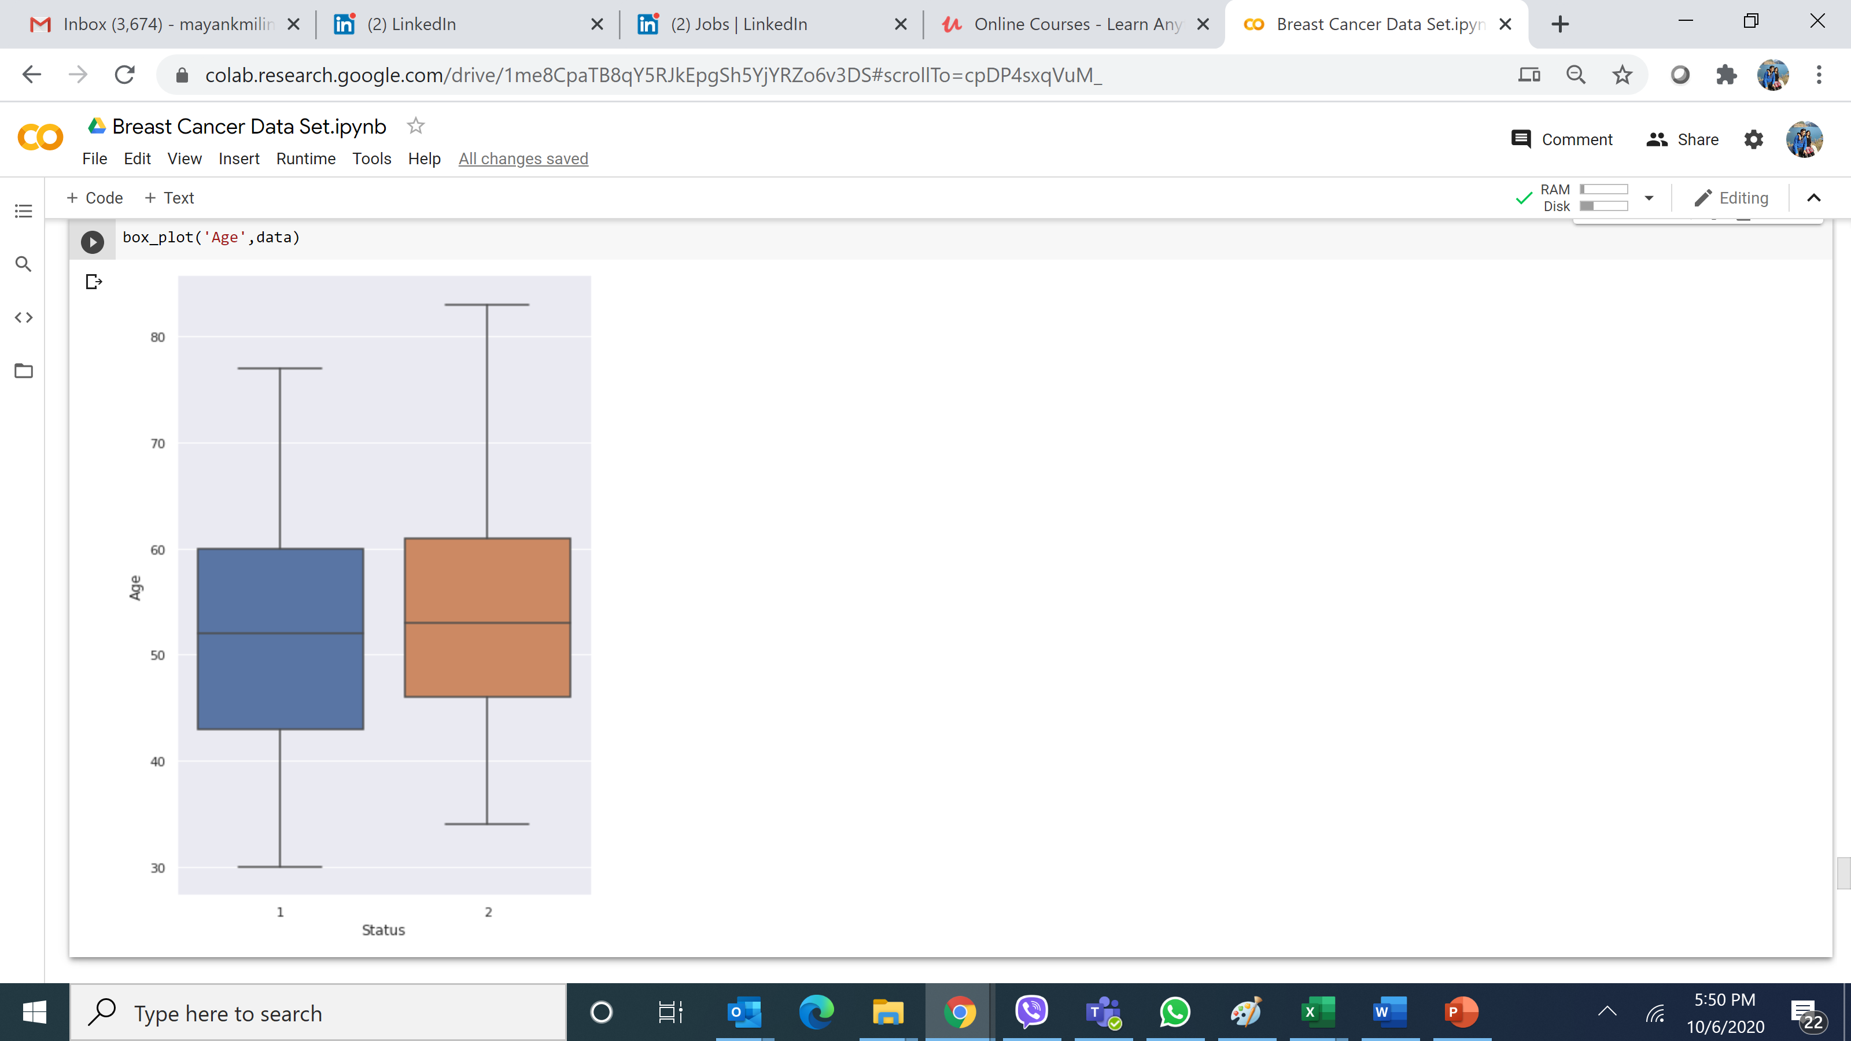
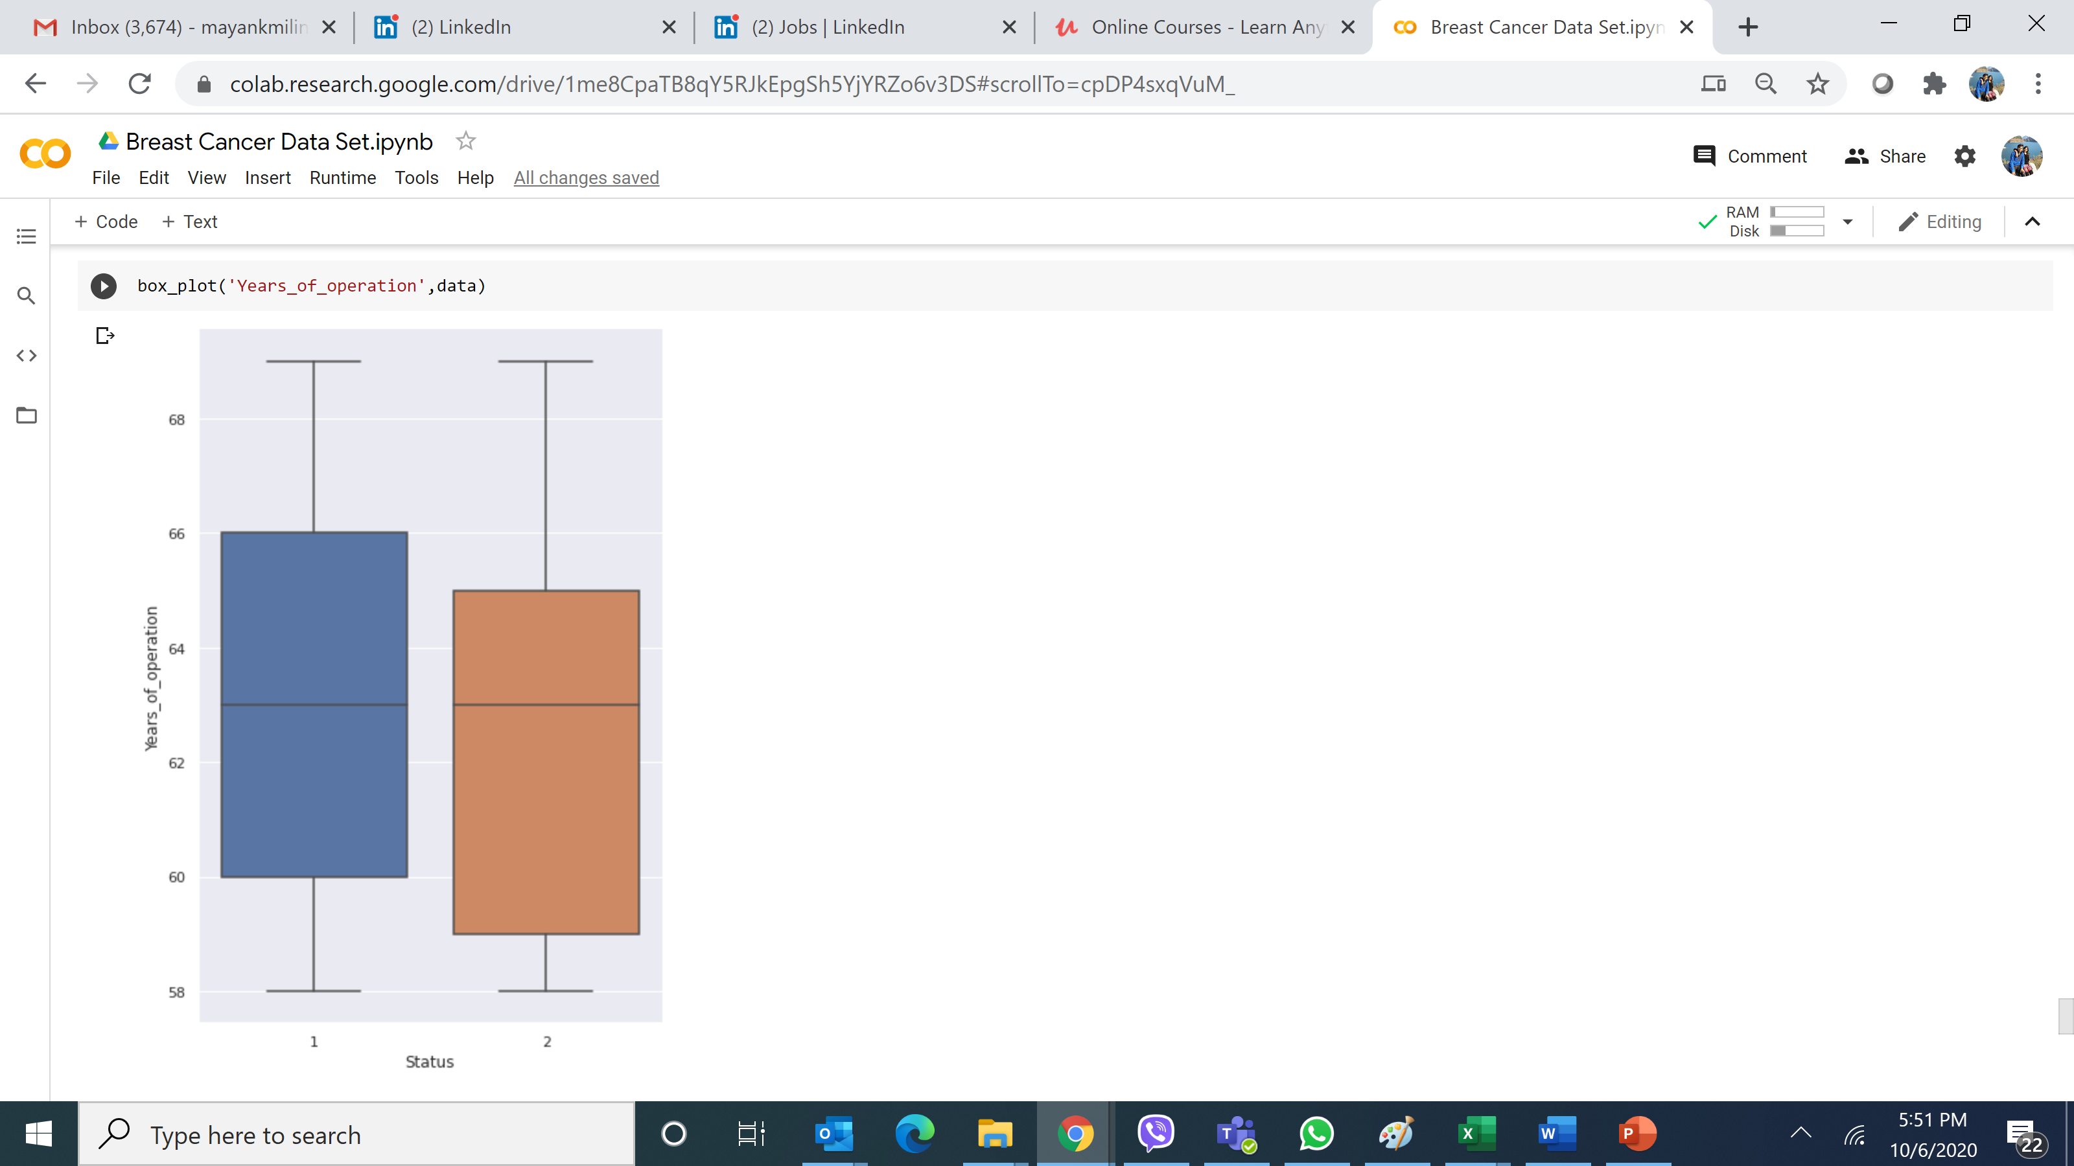
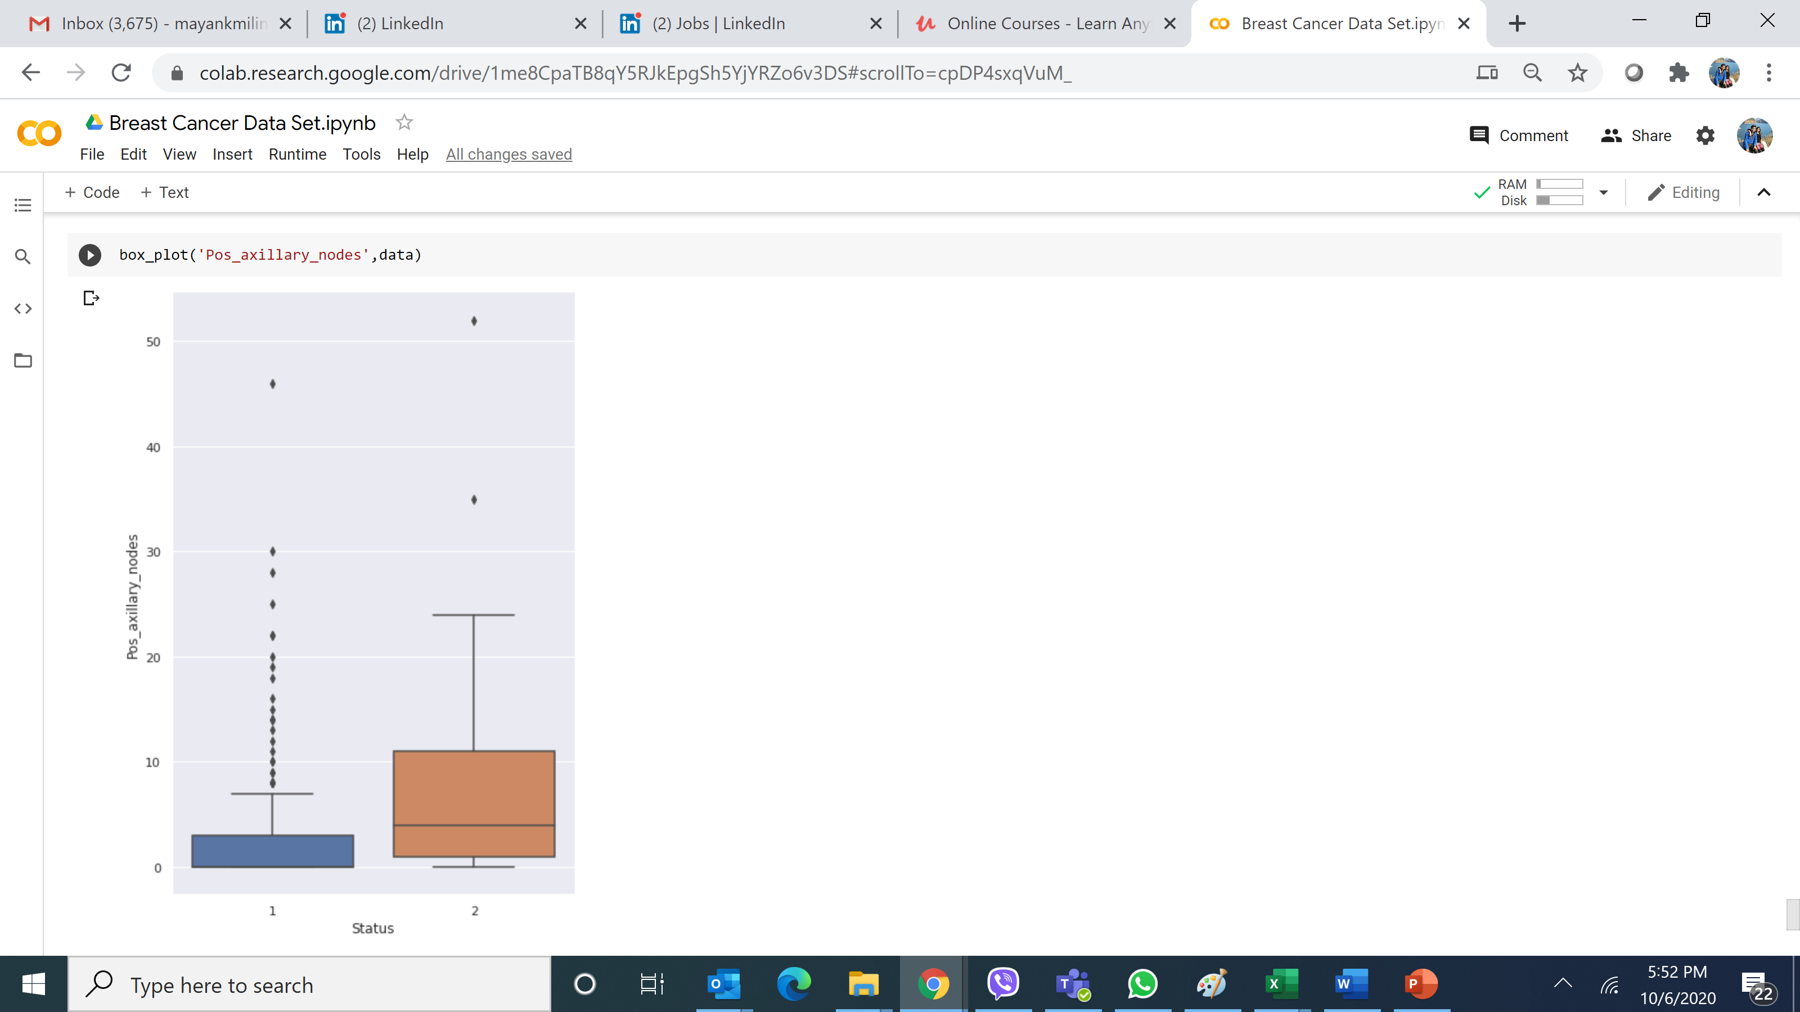
Explaining the Data Variables in terms of Survival and Non-Survival

Slide 15
Thanks

